Slide 1
IBM Data Science Course
Capstone Project – The Battle of Neighborhoods
Venue Selector Application
Ashish Agarwal
January 2019

Slide 2
Business problem
People can search on internet for most popular vacation spots but they don’t get an option to select one or more criteria based on which data can be presented for different cities. As a user, I would like to evaluate different cities in world based on my criteria and preference.
People would want to rate the cities based on criteria like food, arts, entertainment, recreation, stadium, universities, events etc.
To provide a solution to this challenging problem, a new business venture in the shape of a mobile or web application is proposed.
Users can select one or more cities, select one or more categories and then the application will provide comparison of these cities based on available data for likes, cost, activities, trends etc.

Slide 3
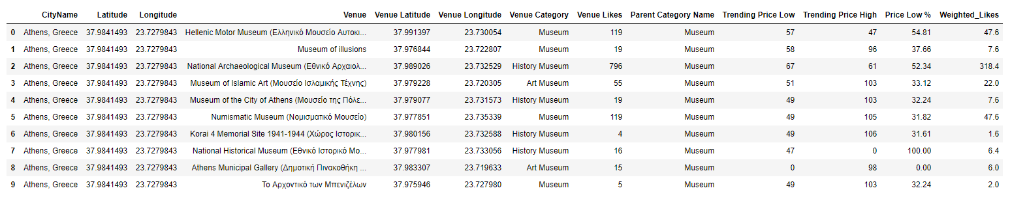
Data Details
Users will input some initial data
Cities which they want to evaluate
Categories based on which they want to evaluate like food, arts, events etc.
Weightage for each category (optional)
Analytics data will be fetched using the following API’s
FourSquare API – search, explore, and like
Nominatim geocoding API

Slide 4
Data Description
The dataframe and the details of the columns on which analysis will be done is as below:
City Name: Name of the city
Latitude: Latitude of the city
Longitude: Longitude of the city
Venue: Top 50 of the venues of a city
Venue Category: Category to which the venue belongs
Venue Likes: Likes entered by users for this venue
Trending Price: Number of users who have rated this venue for low or high price
Price Low %: Percentage of low price number
Weighted_Likes: Venue likes multiplied by weights

Slide 5
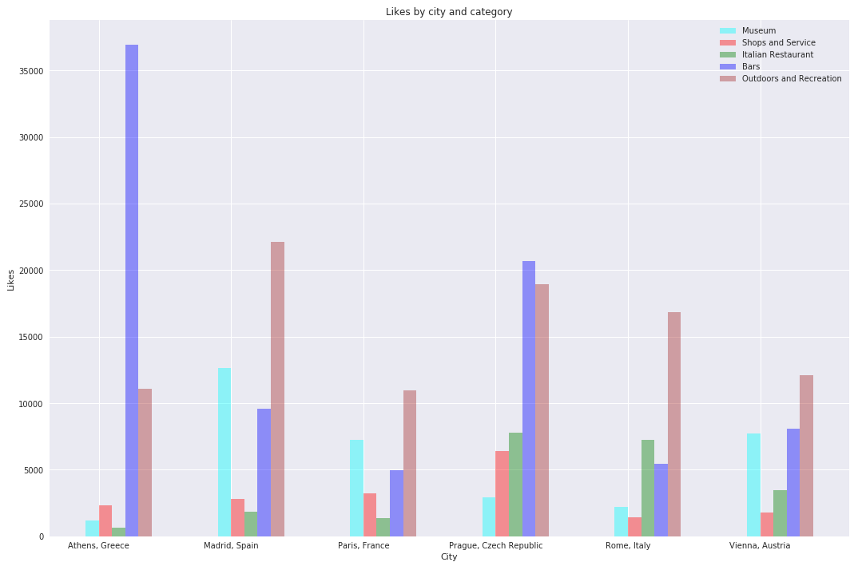
Data Visualizations
Bar Chart showing Venue Likes for each city and category.
Displays a comparative analysis of each city against various categories.

Slide 6
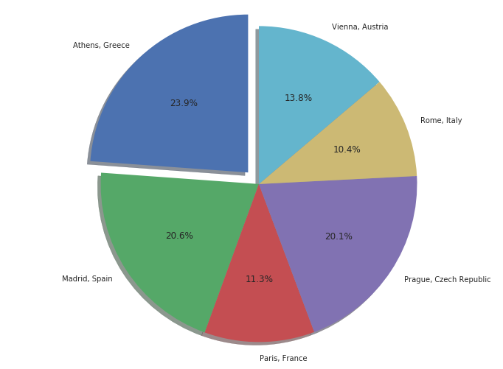
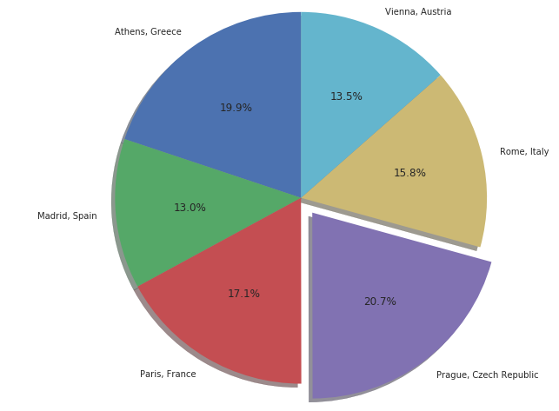
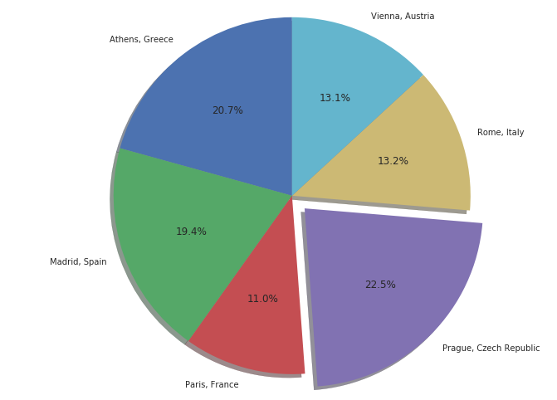
Data Visualizations
Pie Charts – are drawn for three difference deciding factors
Venue Likes
Weighted Venue Likes
Low cost percentage
The pie with maximum effect is expanded.
All pies shows the percentage of the total

Slide 7
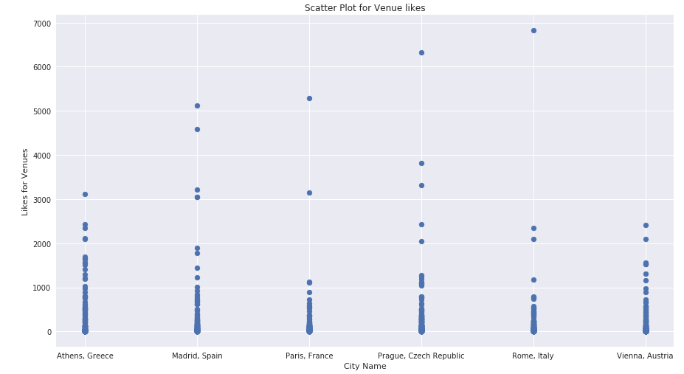
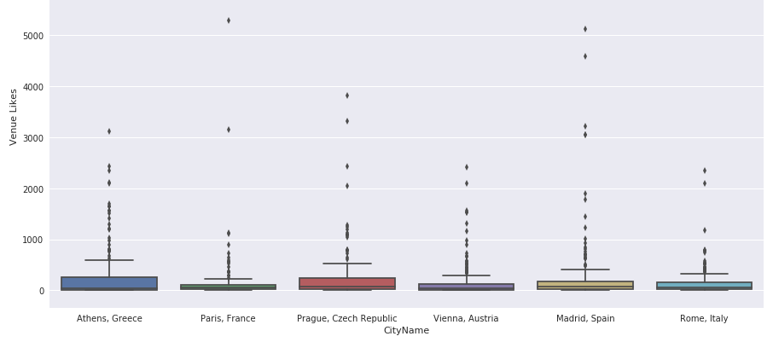
Data Visualizations
BoxPlot – drawn to understand the distribution of data based on five number summary
ScatterPlot – Two dimensional graph representing ‘Venue Likes’ and ‘City Names’
Both charts display the data is very distributed and can be refined to reduce variations.
There are some outliers which needs to be eliminated

Slide 8
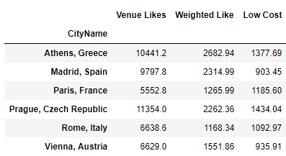
Final Results and Analysis
Athens: Very Good venue likes, Highest Weighted likes, but cost/price is also second highest of all cities
Madrid: Both Venue and weighted likes are third in list. However the cost/price is highest.
Paris: Both Venue and weighted likes are lowest and the cost/price is also average in the list.
Prague: Highest Venue likes and lowest cost/price. So this seems the best in the list of cities.
Rome: Average venue and weighted likes, but cost is towards higher side.
Vienna: Average venue and weighted likes. However cost is towards lower side.

